Slide 1
EIGRP FUNDAMENTALS
An overview

Slide 2
Topics
Review of Routing Protocols and Introduction to EIGRP
EIGRP Fundamentals
EIGRP Packets
Neighbour Discovery and Adjacency
EIGRP Data structures
Neighbour states
EIGRP Router States
EIGRP Metric Calculations
EIGRP Configuration for IPv4
EIGRP Configuration for IPv6

Slide 3
Terminologies
Autonomous System: A collection of IP networks and routers under a common administration with a consistent routing policy.
Autonomous System Number: this is a number that represents a certain AS . It is between 1 - 65535
Neighbour: A router with which another router forms a direct adjacency to exchange routing information.
Administrative distance: This is a value that depicts the trustworthiness of a routing protocol.
Metric: A measure used to determine the "cost" of reaching a destination network. EIGRP's metric is based on various factors such as number of hops, bandwidth, delay, reliability, and load

Slide 4
Terminologies
Feasible distance: This is the total cost to reach a destination network from a router
Reported Distance: This is the total cost to reach a destination network as reported by a router’s neighbour
Successor route: This is the route with the lowest cost to reach the destination network
Feasible successor: route: the is the route which serves as a backup to a destination. This route must match a condition called feasibility condition

Slide 5
Terminologies
Feasible distance: this is the total cost to reach a destination network from a router
Reported Distance: this is the total cost to reach a destination network as reported by a router’s neighbour
Successor route: the is the route with the lowest cost to reach the destination network
Feasible successor route: the is the route which serves as a backup to a destination. This route must match a condition called feasibility condition

Slide 6
EIGRP Packets
Hello packet: Hello packets out of all active interfaces that have EIGRP enabled. Hello packets are multicast messages sent periodically (default is every 5 seconds) to the multicast address 224.0.0.10 (IPv4) or FF02::A (IPv6) .
Request Packet
Update Packet: Update packets contain routing information updates and are used to share information about network topology changes.
Query Packet: Query packets are used in the event of a topology change, such as a link failure.
Reply packet: Reply packets are sent in response to query packets

Slide 7
Neighbour Discovery and Adjacency
Hello Protocol Initialization
Hello Packet Reception
Neighbour Verification
Adjacency is established

Slide 8
Router/Interface EIGRP STATES
Passive: Router has completed all eigrp calculation
Active: router just initialise hello, or change in topology, router sends update, or query packet

Slide 9
EIGRP Data Structures
A data structure is a specialised format for storing, organising, processing, and retrieving data.
EIGRP has 3 Tables
Neighbour table
Interface table
Topology table

Slide 10
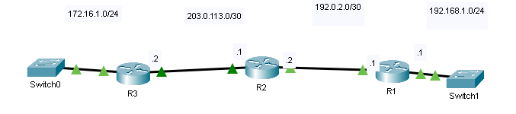
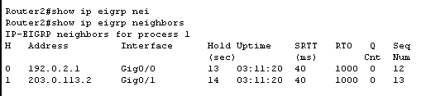
EIGRP Data Structures: Neighbour table
Information found are:
Neighbour IP address
Int through which kneeboard is reachable
Hold time
Uptime
Retransmit time out
EIGRP Packets on queue

Slide 11
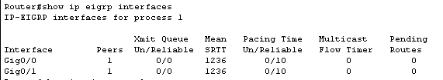
EIGRP Data Structures: Interface table
Information found are:
Which interfaces participate in EIGRP
The interface name
The Smooth Round-Trip Time

Slide 12
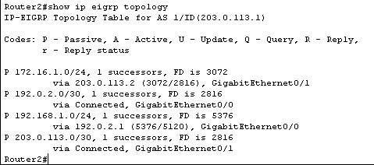
EIGRP Data Structures: Topology table
Information found are:
Routing table
Interface through which route was learnt
Successor route
Feasible route
Reported distance
Feasible distance
Route type

Slide 13
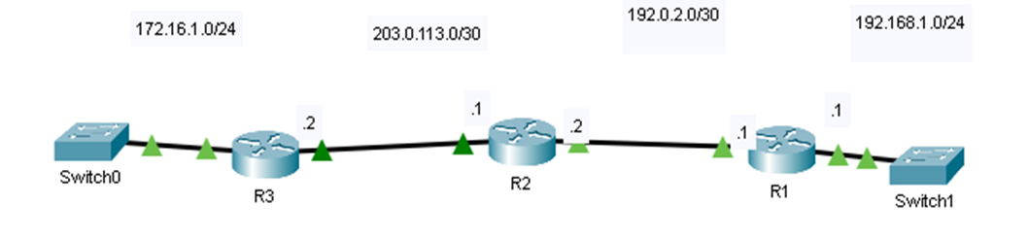

Metric Calculation
Formular for calculating bandwidth
$$metric=\frac{{10}^{7}}{minimum bandwidth}+ \frac{Total Delay}{10}$$
The total delay is the delay from $R_{1}$ to $R_{n}$

Slide 14
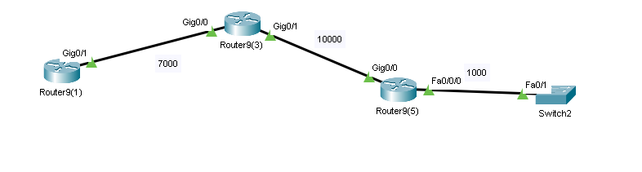
Metric Calculation

Slide 15
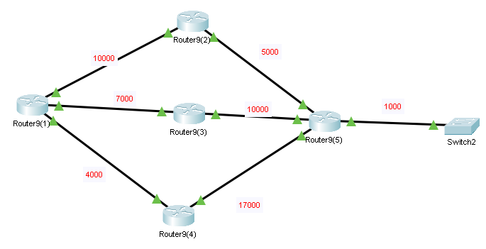
Path Selection

Slide 16
Path Selection
Neighbour | Reported Distance | Feasible Distance | Route status

